Slide 1

Vehicle Safety & Alert System
Presented By
MD. MYMO ZAMAN SHIHAB (885)
APURBO ROY (909)
MD. SHAHARIAR SIAM (903)
SUMAIYA TUSFI (884)
Academic Details
Faridpur Engineering CollegeDepartment of Electrical & Electronic Engineering
Supervised By: Mr. Tonmoy Chowdhury SuhelLecturer, Department of EEE
Submission: November 11, 2025

Slide 2
Presentation Outline
Institute Details
Project overview and team introduction
Introduction
System capabilities and core technologies
Objectives
Primary goals and system requirements
Methodology
Technical approach and implementation strategy
System Flowchart
Operational logic and event handling
Future Enhancements
Potential upgrades and advanced features

Slide 3


Introduction
An ESP32 Based intelligent monitoring and alert solution combining cutting-edge sensor technologies for enhanced vehicle safety and emergency response.
Multi-Sensor Integration
GPS tracking, GSM communication, RFID access control, IMU motion sensing, and IR speed detection
Real-Time Alerts
Instant SMS and call notifications during critical events like impacts, unauthorized access, or speed violations
Live Monitoring
Continuous updates via OLED display and serial monitor for driver awareness and system status

Slide 4
System Objectives
GPS Tracking
Continuous GPS tracking with fallback
Impact & Rotation Detection
Impact/rotation detection with instant buzzer + GSM alerts
RFID Monitoring
RFID access monitoring with danger warnings
Speed Enforcement
Speed enforcement via IR encoder with staged escalation
System Feedback & Reporting
Real-time system feedback and comprehensive reporting

Slide 5






Development & Implementation
PCB Design
Created comprehensive schematic and professional layout using EasyEDA Pro
PCB Fabrication
Professional PCB manufacturing service for high-quality board production
Component Procurement
Sourced premium electronic components from verified trusted vendors
Assembly & Soldering
Precision soldering of all components onto fabricated PCB with quality control
Firmware Development
ESP32 programming using Arduino IDE with specialized sensor libraries
Testing & Integration
Comprehensive system verification and successful demonstration of all features

Slide 6
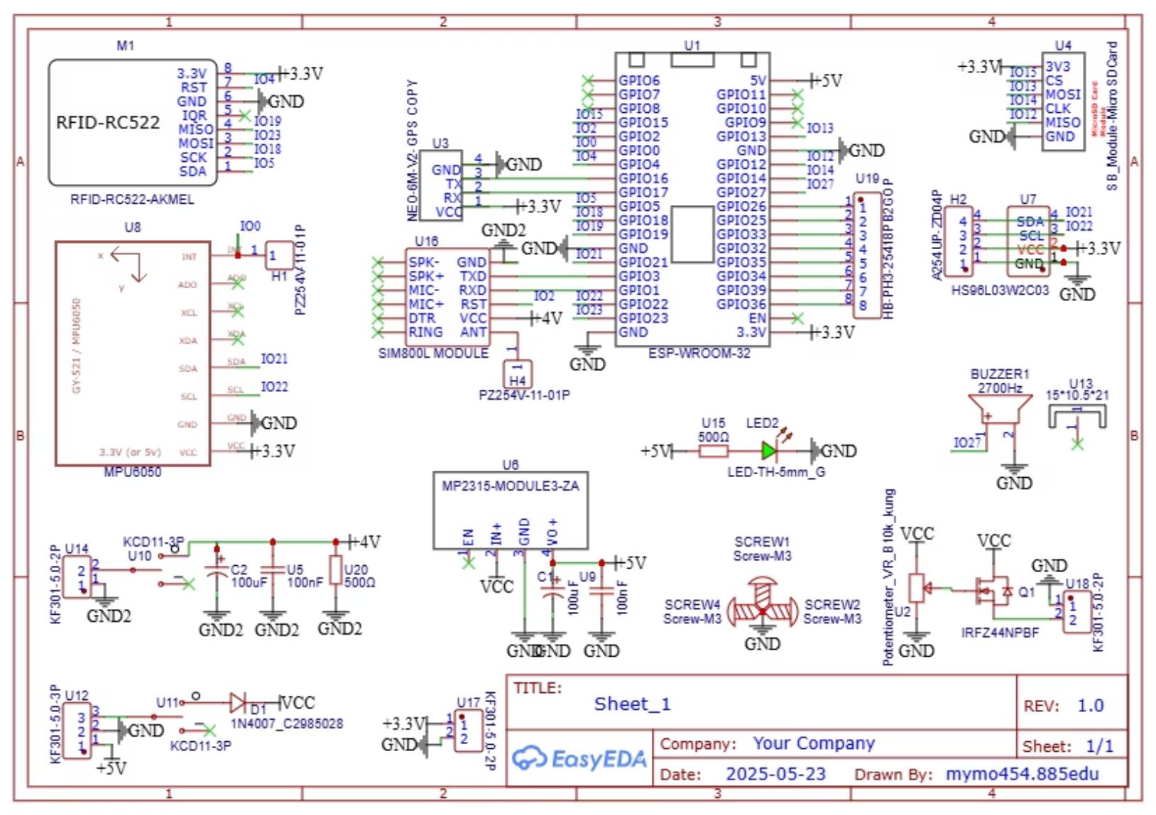
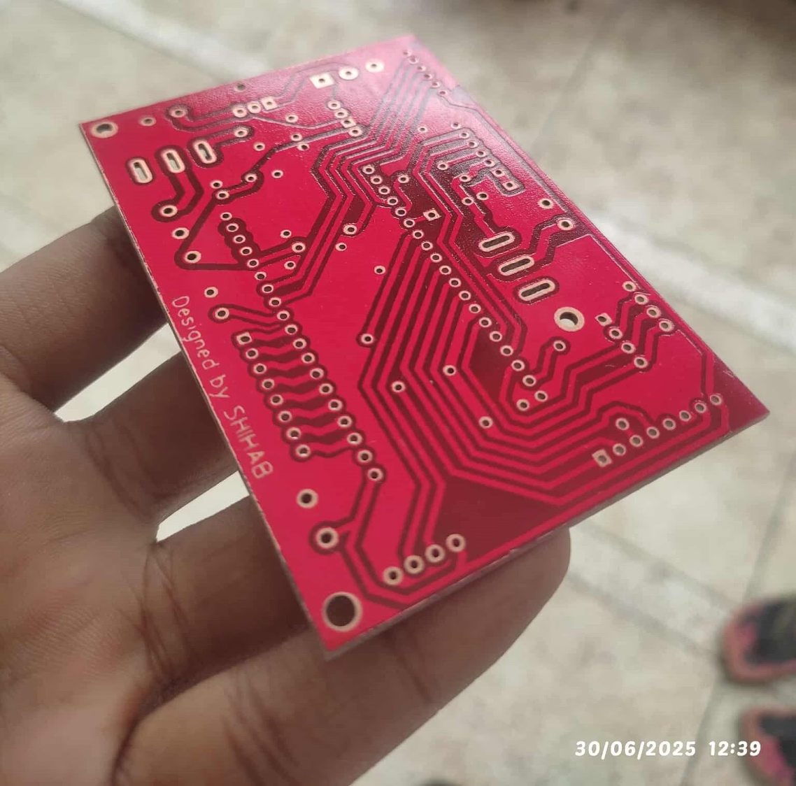
Design & Fabrication Project PCB
Professional Circuit Design
High-Quality PCB Fabrication
Detailed and precise circuit design, meticulously engineered for optimal performance and reliability in critical applications.
Experience professional-grade manufacturing with our high-quality PCBs, built to exacting standards for durability and functionality.

Slide 7
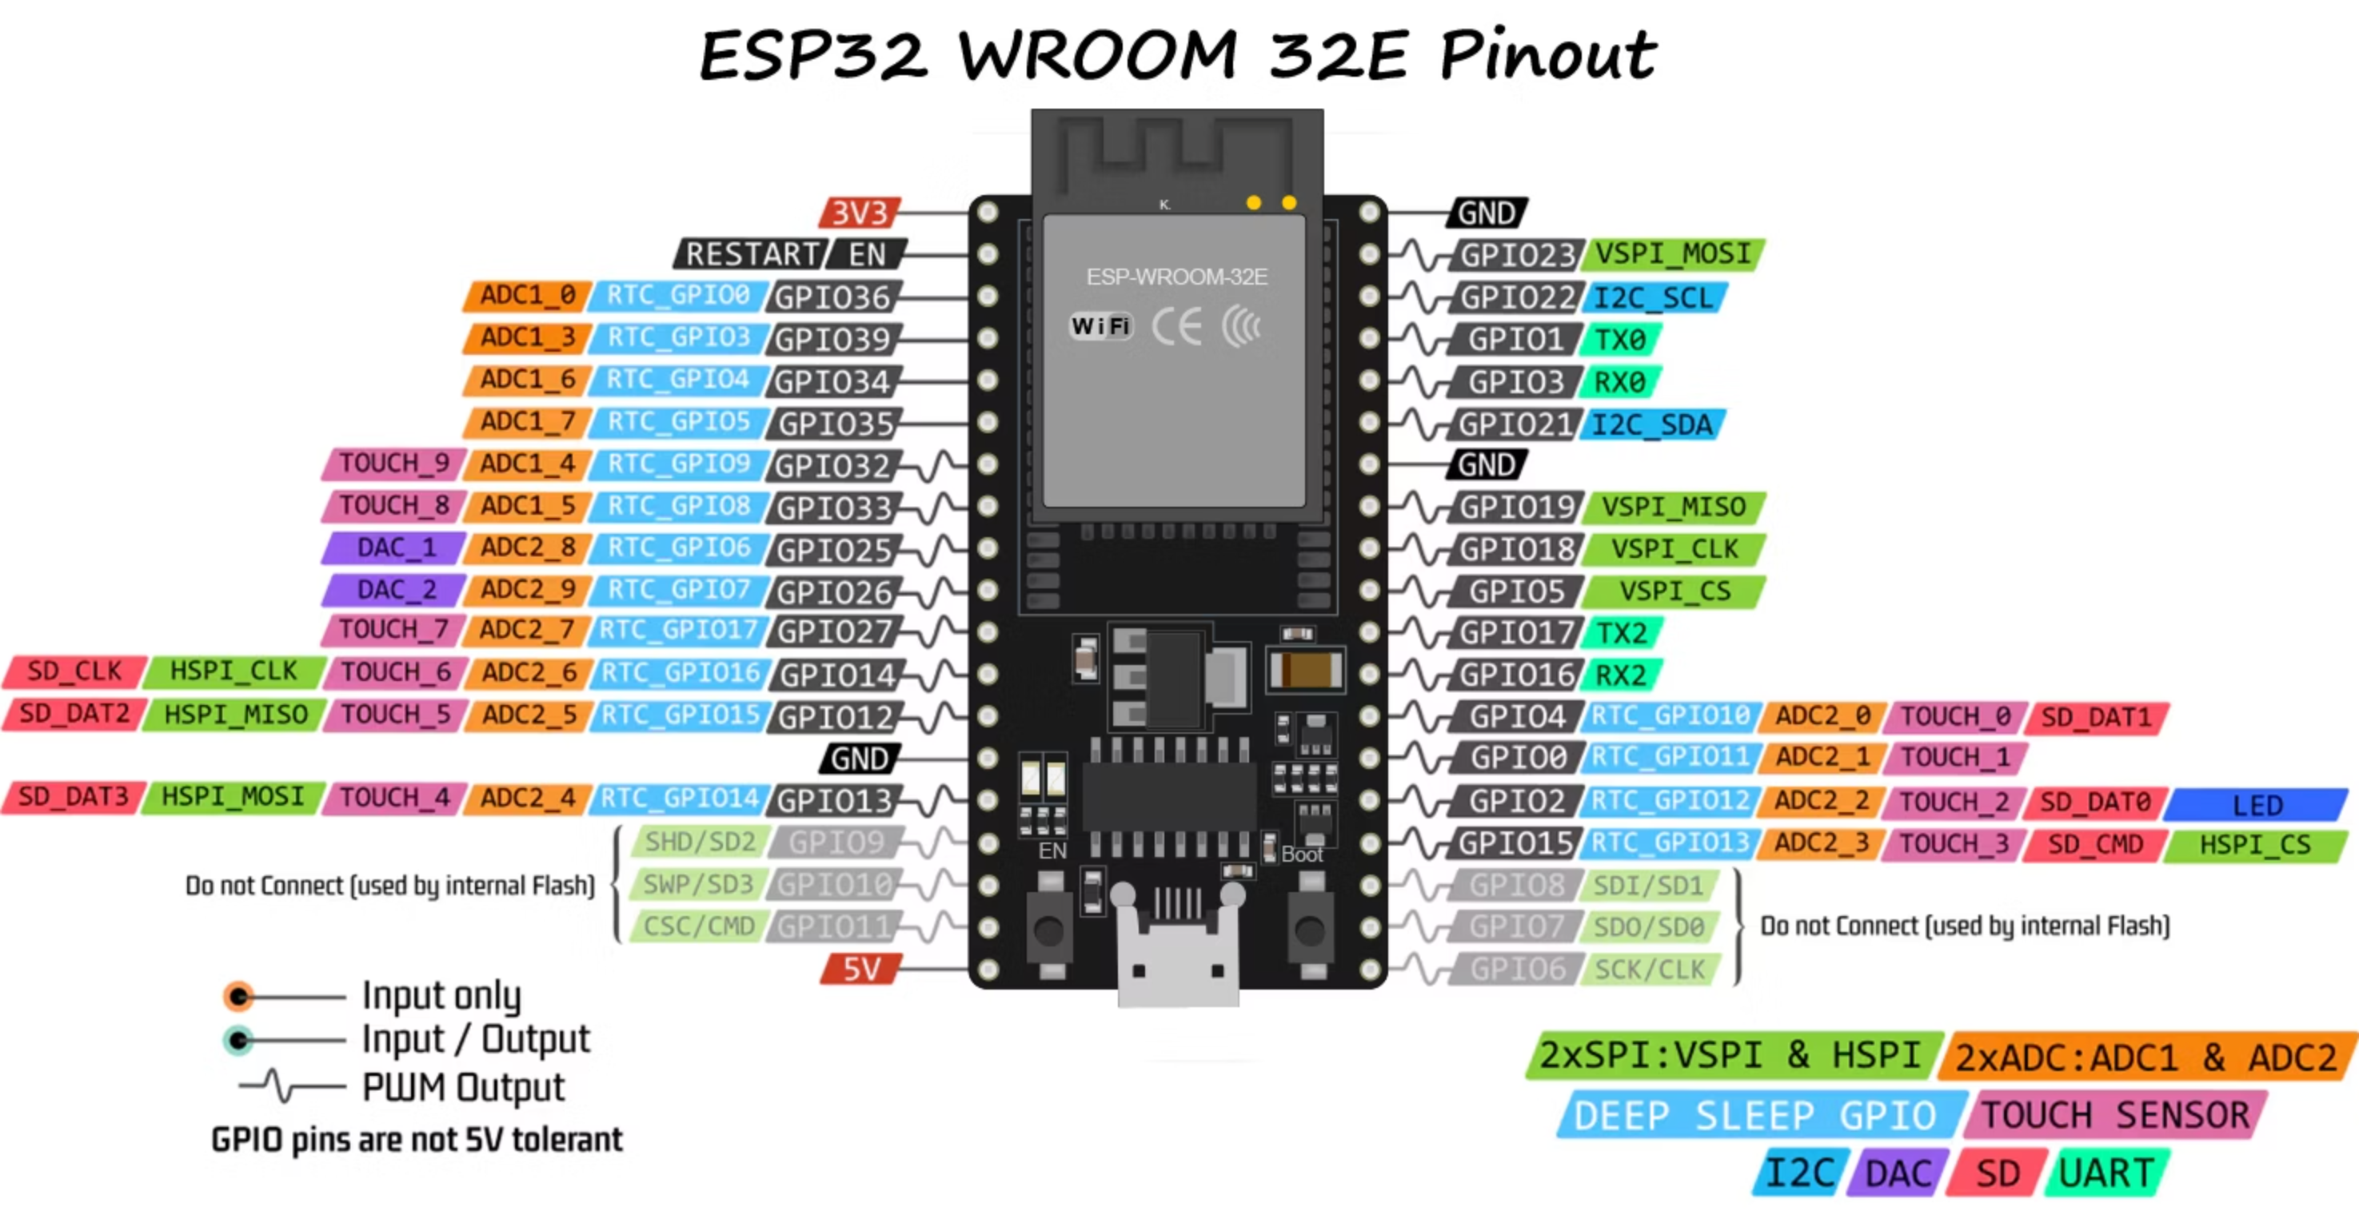
Microcontroller Architecture & Pin Configuration
Dual-Core
Connectivity
Efficient multi-tasking & real-time processing.
Integrated WiFi & Bluetooth.
GPIO Pins
Central CPU
Flexible I/O for sensors & actuators.
Manages detection & communication.

Slide 8
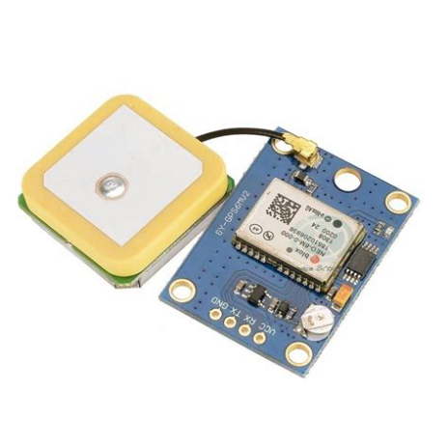
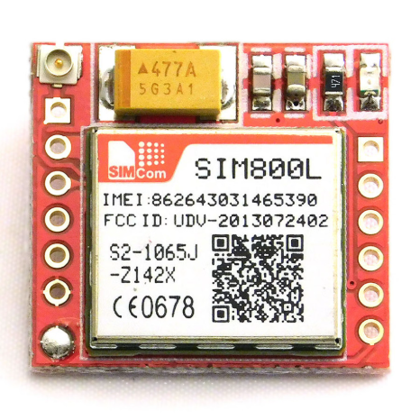
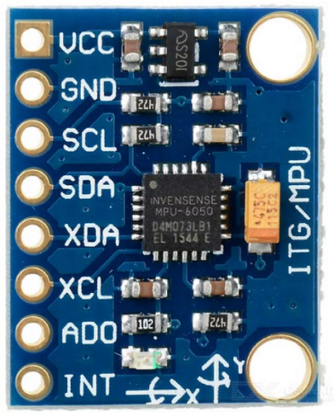
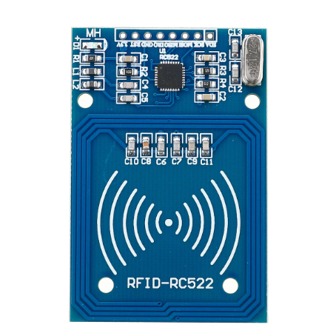
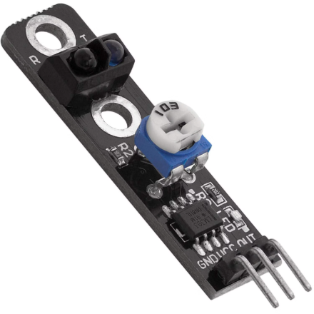
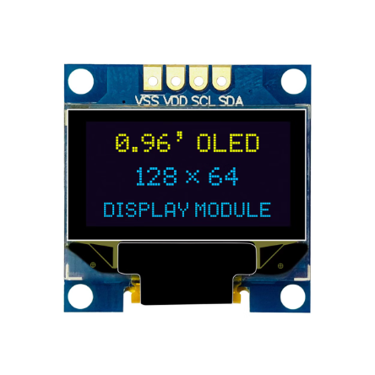
Essential System Components
U-Blox Neo-6M GPS
SIM800L GSM
MPU6050 IMU
Provides precise location data for tracking and navigation.
Enables cellular communication for remote data transmission.
Integrates accelerometer and gyroscope for motion sensing.
RFID RC522
IR Sensor
0.96" OLED Display
Facilitates contactless identification and data exchange.
Detects presence of objects or measures distance using infrared.
Compact, high-contrast screen for clear visual feedback.

Slide 9
Technical Methodology
1
System Initialization
GPS attempts location fix (60-second timeout), GSM network connection established, fallback coordinates activated if needed
2
Continuous Monitoring
MPU6050 IMU detects shocks and rotations, RFID RC522 scans for authorized cards, IR sensor measures speed and distance
3
Event Processing
Shock/rotation triggers buzzer + SMS/call alerts, RFID detection sends danger warnings, overspeed violations escalate progressively
4
Real-Time Output
OLED display and serial monitor provide live location data, current speed readings, and system status updates

Slide 10
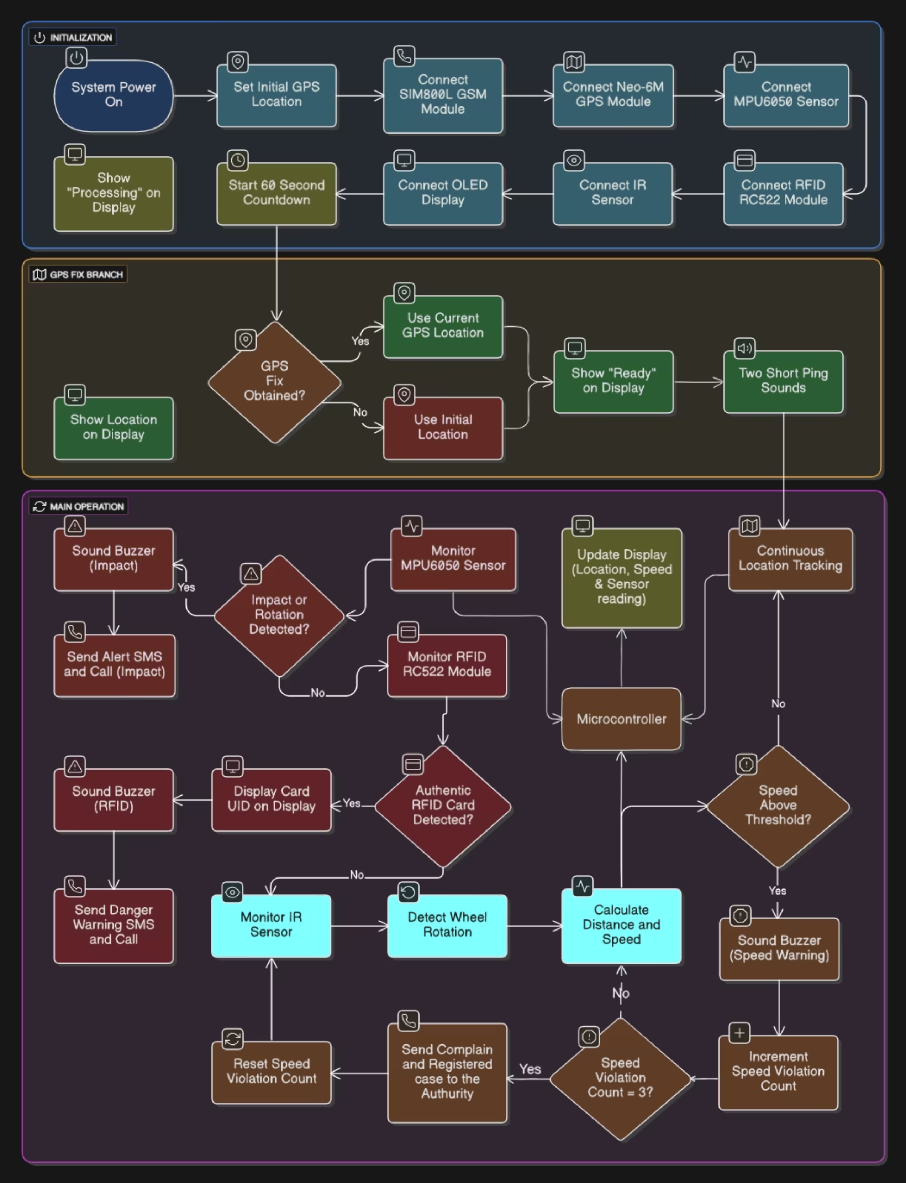
System Working Flowchart
Complete operational flow diagram showing system initialization, monitoring phases, event detection, and response mechanisms.

Slide 11
Future Enhancements
Cloud Dashboard
SMS Remote Commands
Real-time remote monitoring capabilities via MQTT/HTTP protocols for fleet management
Bidirectional communication allowing remote system queries and control via SMS interface
Advanced Security
OTA Updates
Tamper detection, anti-theft sensors, and comprehensive intrusion monitoring features
Over-the-air firmware upgrades enabling seamless system improvements without physical access
Next-generation vehicle safety through advanced connectivity and intelligent monitoring systems.

